Slide 1
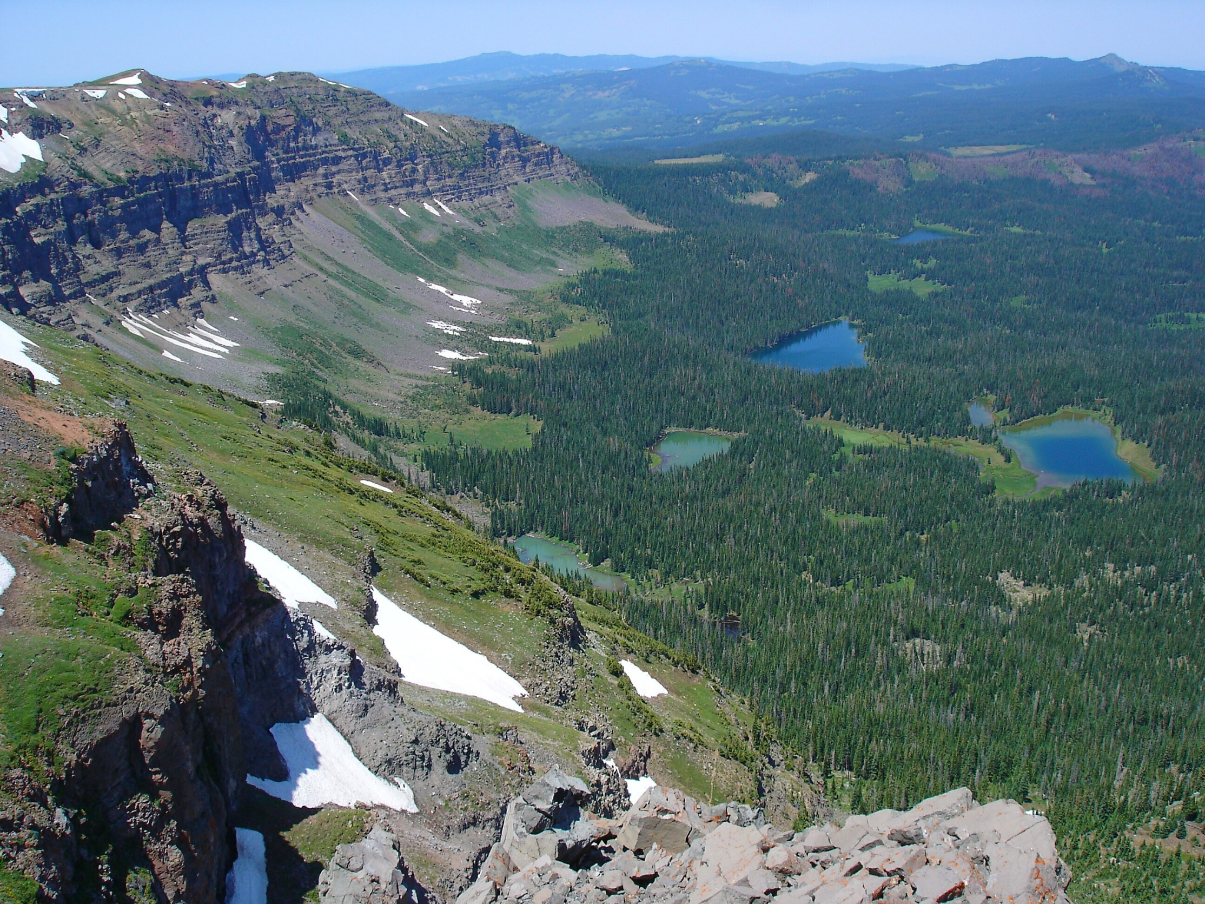
Mapping Hydrologically-Sensitive Environments in Alpine Forests of the Western United States Using Remote Sensing and GIS
Justin Wells
UNC Wilmington

Slide 2
Study Area
Justin Wells

Slide 3
Study Area
Justin Wells

Slide 4
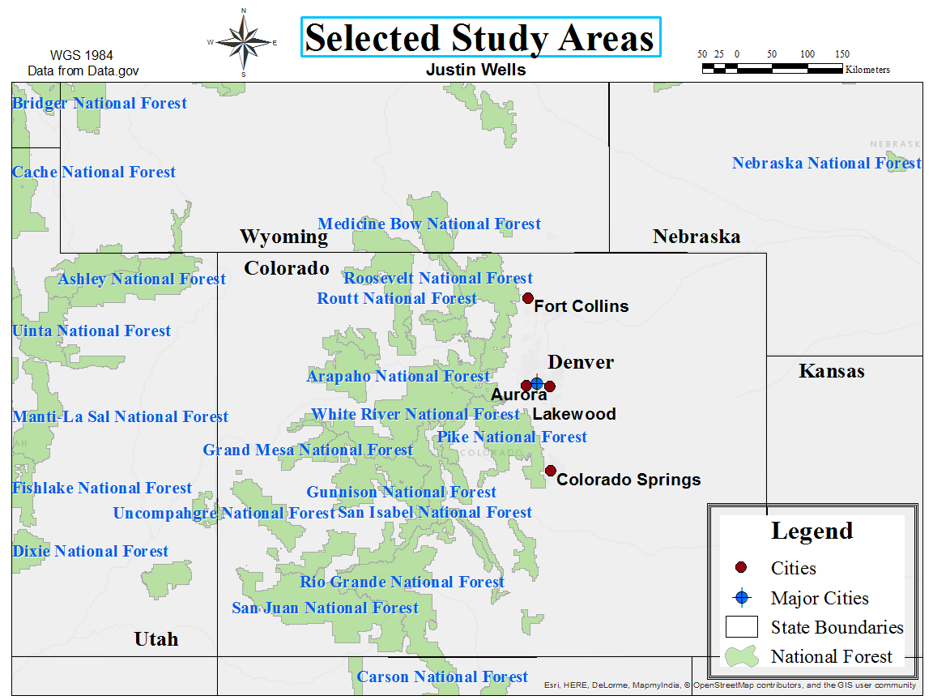
Study Area
Justin Wells

Slide 5
Study Area
Justin Wells

Slide 6
Snowmelt penetrates surface soil into subsurface aquifer
Basic Hydrology of Study Area
Justin Wells

Slide 7
Basic Hydrology of Study Area
Groundwater flows downhill
Justin Wells

Slide 8
Basic Hydrology of Study Area
Glacier lakes, and Groundwater-Dependent Ecosystems (GDEs) form where the water table intersects earth’s surface
Justin Wells

Slide 9
Basic Hydrology of Study Area
Glacier lakes, and Groundwater-Dependent Ecosystems (GDEs) form where the water table intersects earth’s surface
Justin Wells

Slide 10
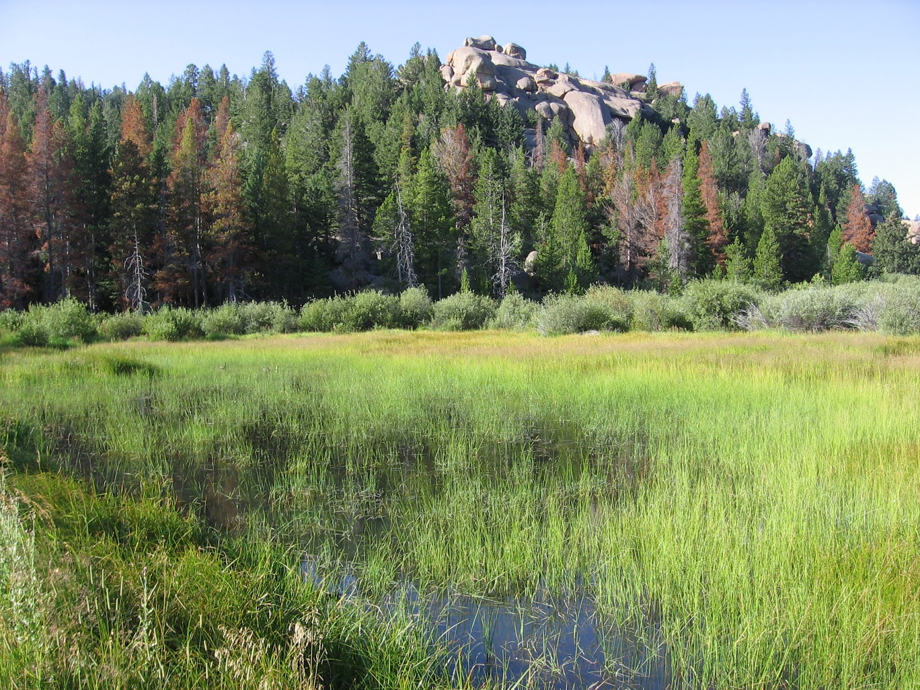
Groundwater-Dependent Ecosystems
Justin Wells

Slide 11
Groundwater-Dependent Ecosystems
>50% reliance on groundwater input
Includes, fens, springs, and riparian wetlands
Typically dominated by sedges, moss, willow and forbs in this area
Important hydrologic surface expressions for geospatial classification
Justin Wells

Slide 12
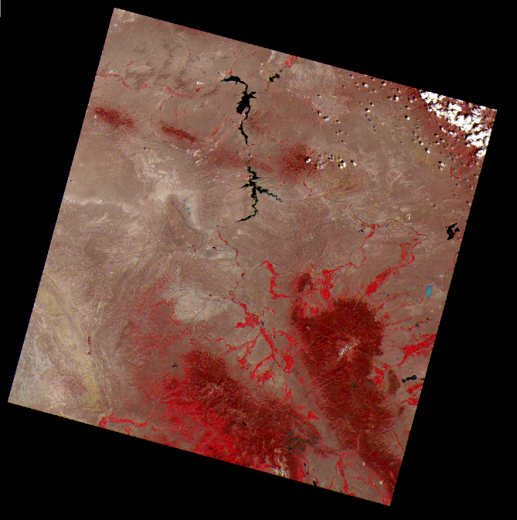
Workflow
Landsat 8 OLI
Justin Wells

Slide 13
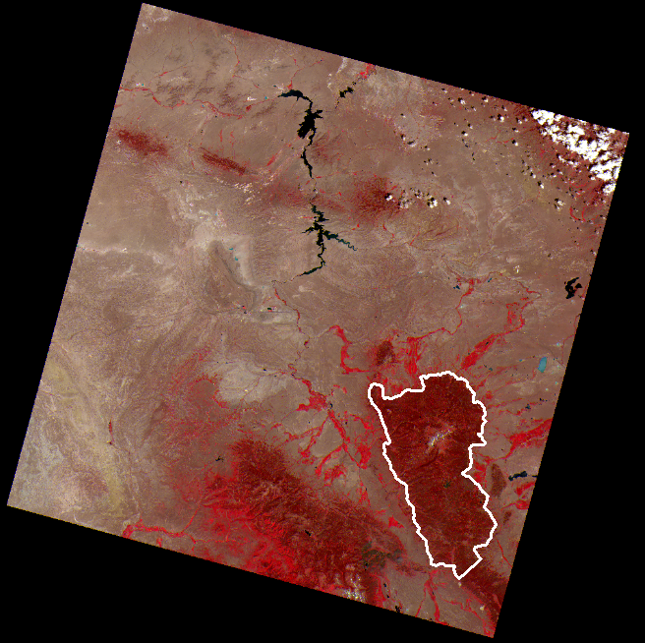
Workflow
Landsat 8 OLI
Clip
Justin Wells

Slide 14
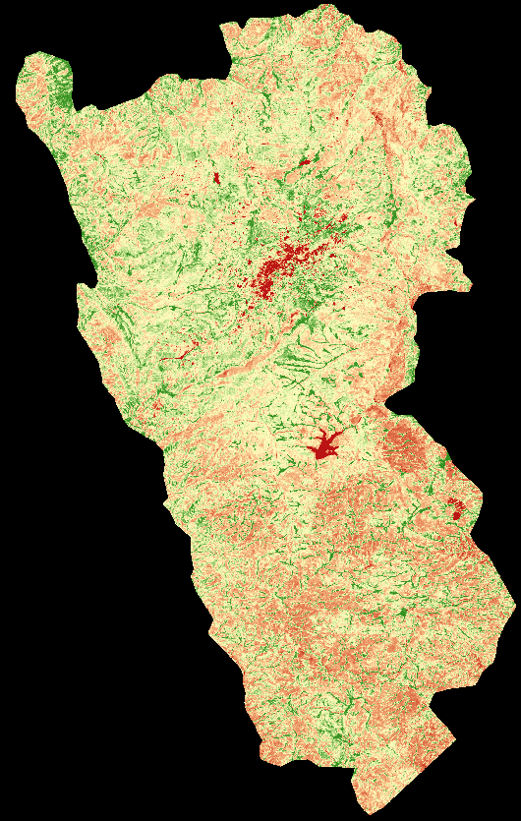
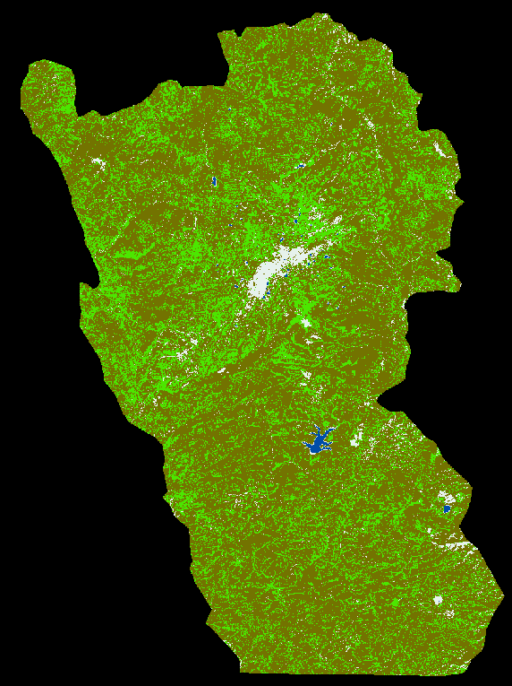
Workflow
NDVI
Landsat 8 OLI
Clip
Supervised
Classification
Justin Wells

Slide 15
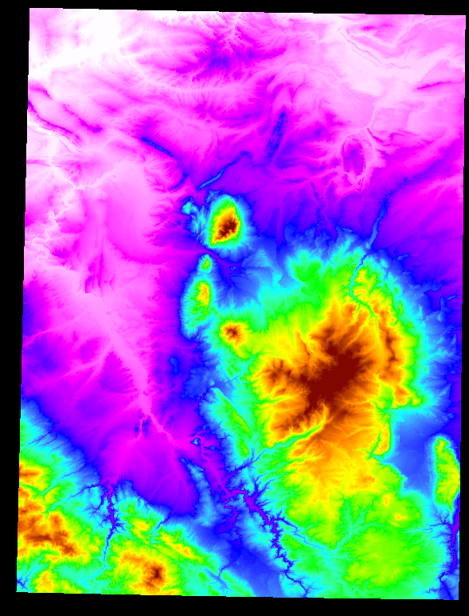
Workflow
NDVI
Landsat 8 OLI
Clip
Supervised
Classification
Digital Elevation
Model
Justin Wells

Slide 16
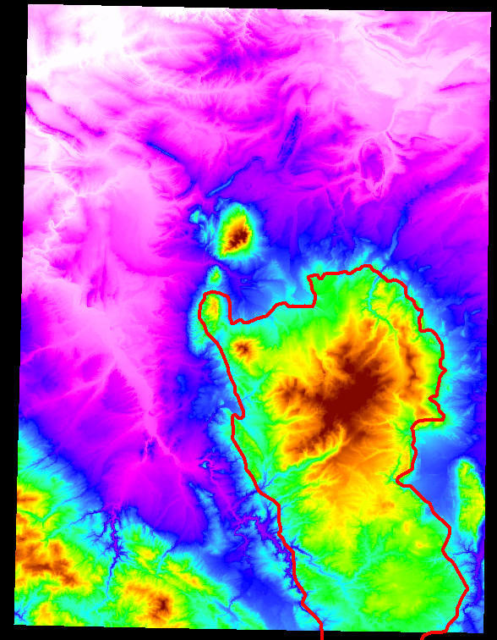
Workflow
NDVI
Landsat 8 OLI
Clip
Supervised
Classification
Digital Elevation
Model
Clip
Justin Wells

Slide 17
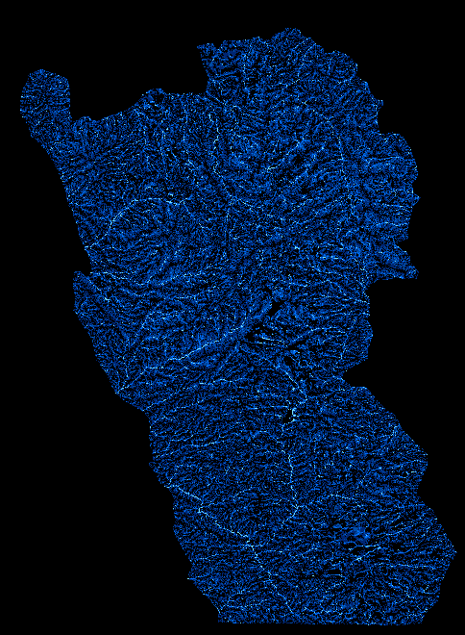
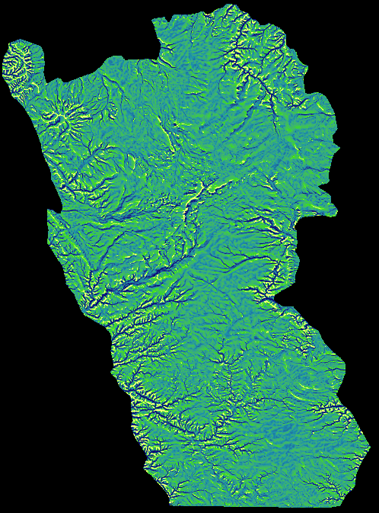
Workflow
NDVI
Landsat 8 OLI
Clip
Supervised
Classification
Digital Elevation
Model
Clip
Slope
CTI
Flow
Justin Wells

Slide 18
Workflow
NDVI
Landsat 8 OLI
Clip
Supervised
Classification
Calculate
Difference
Filter
Digital Elevation
Model
Clip
Slope
CTI
Flow
Justin Wells

Slide 19
Workflow
NDVI
Reclassify
Landsat 8 OLI
Clip
Supervised
Classification
Reclassify
Calculate
Difference
Filter
Reclassify
Digital Elevation
Model
Clip
Slope
CTI
Reclassify
Flow
Justin Wells

Slide 20
Workflow
NDVI
Reclassify
Landsat 8 OLI
Clip
Supervised
Classification
Reclassify
Combined
Likelihood
Calculate
Difference
Filter
Reclassify
Digital Elevation
Model
Clip
Slope
CTI
Reclassify
Flow
Justin Wells

Slide 21
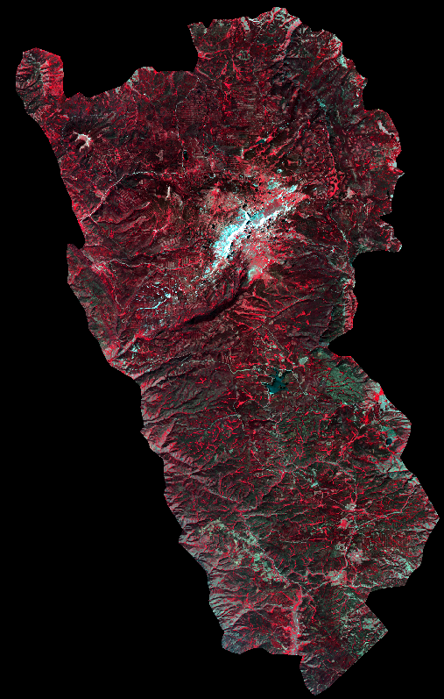

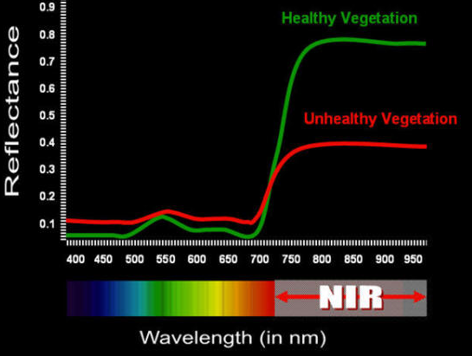


NDVI
Justin Wells

Slide 22
NDVI
NIR
Justin Wells

Slide 23
NDVI
NIR – red
Justin Wells

Slide 24
NDVI
NIR – red
NIR + red
Justin Wells

Slide 25
NDVI
Healthy Vegetation
Stressed Vegetation or Pine Forest
No Vegetation
Justin Wells

Slide 26
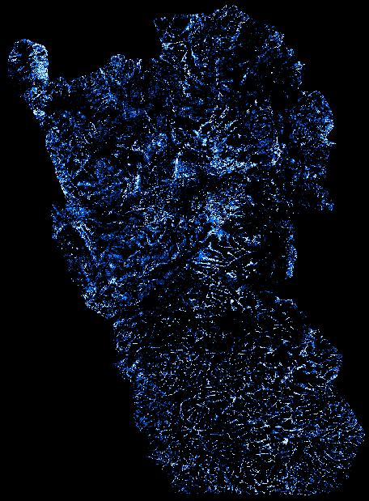

NDVI Reclassified
Most Likely
Least Likely
Justin Wells

Slide 27
Supervised Classification
Maximum Likelihood
Bands 2-7
5 classes
40 GDE reference sites (722 pixels)
91 total reference sites sites (6,529 pixels)
Justin Wells

Slide 28
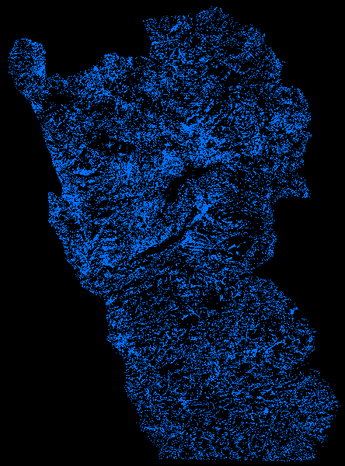

Supervised Classification
Maximum Likelihood
Bands 2-7
5 classes
40 GDE training sites (722 pixels)
91 total training sites (6,529 pixels
Most Likely
Least Likely
Justin Wells

Slide 29


Compound Topography Index (CTI)
Calculate Flow Direction
Justin Wells

Slide 30
Compound Topography Index (CTI)
Calculate Flow Direction
Calculate Contributing Cells
Justin Wells

Slide 31
Compound Topography Index (CTI)
Calculate Flow Direction
Calculate Contributing Cells
Output Flow Accumulation
Justin Wells

Slide 32

Compound Topography Index (CTI)
Output Flow Accumulation
Justin Wells

Slide 33
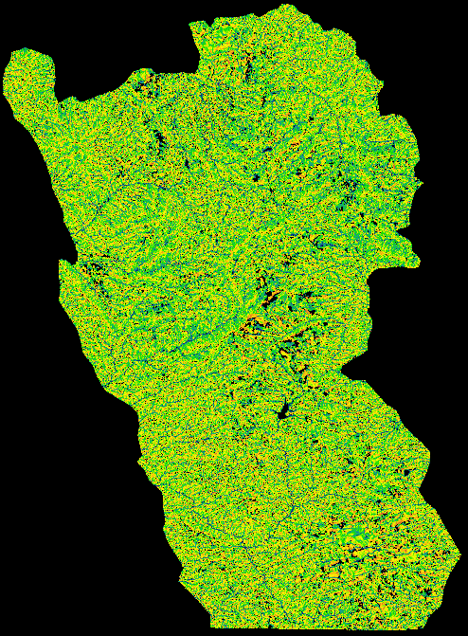
Compound Topography Index (CTI)
High CTI
CTI = Ln( )
contributing area
tan(slope)
Low CTI
Justin Wells

Slide 34
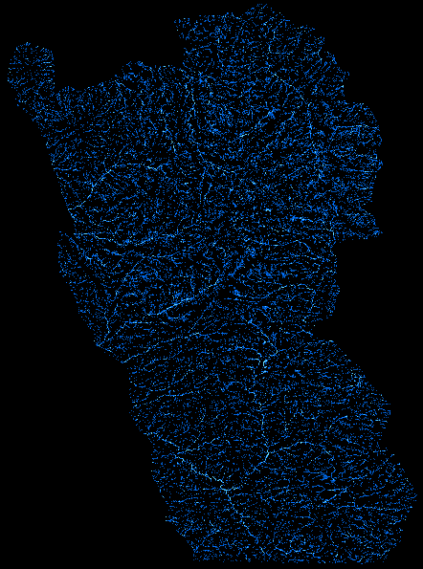

CTI Reclassified
Justin Wells

Slide 35
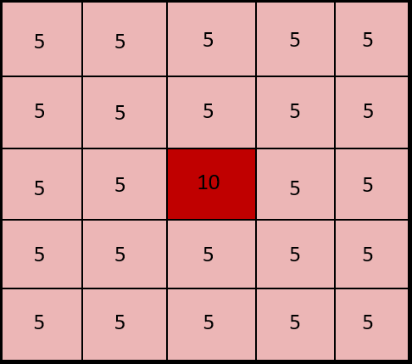
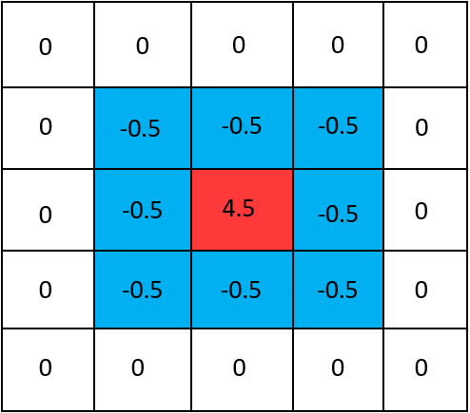

Elevation Filter
Justin Wells

Slide 36

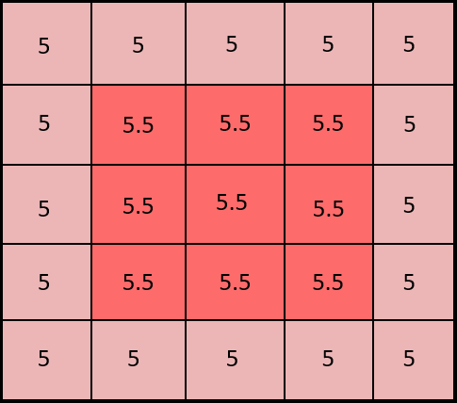

Elevation Filter
Justin Wells

Slide 37

Elevation Filter
Justin Wells

Slide 38


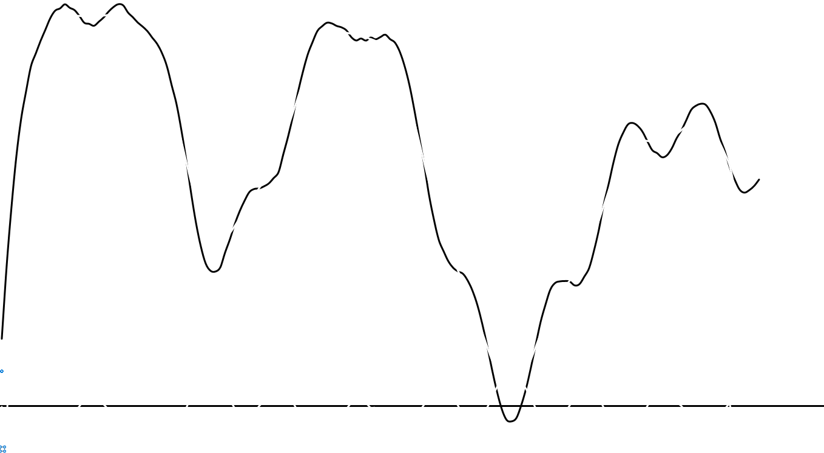
Elevation Filter
Justin Wells

Slide 39
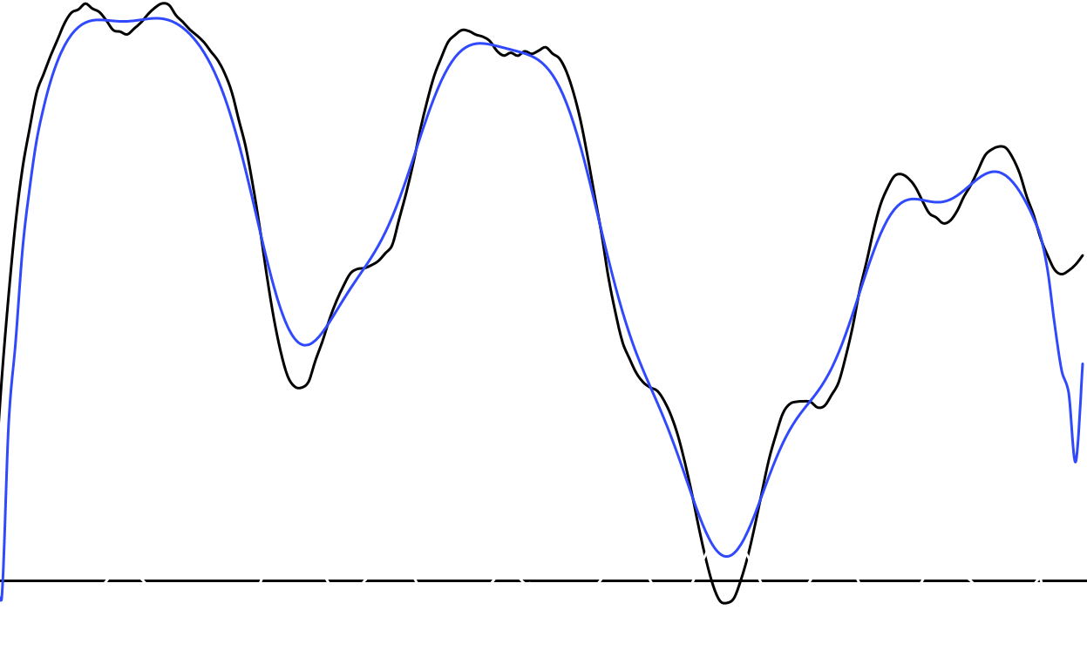
Elevation Filter
Justin Wells

Slide 40
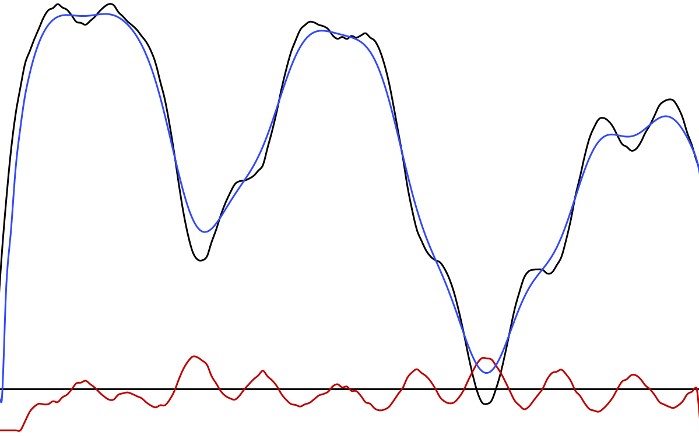
Elevation Filter

Slide 41
Elevation Filter

Slide 42
Filtered elevation minus elevation
Ridge
Valley
Justin Wells

Slide 43
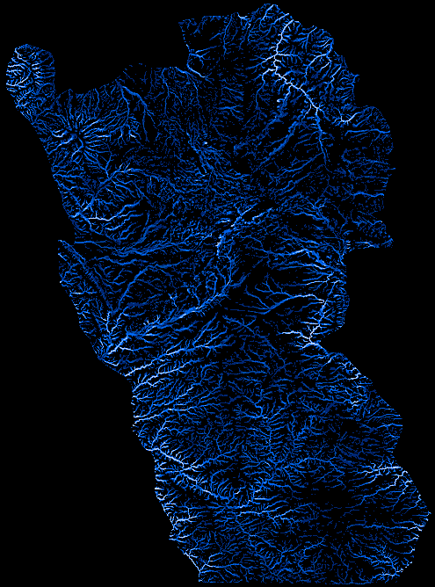

Difference Reclassified
Justin Wells

Slide 44

Combined Likelihood
CTI
NDVI
Multispectral Classification
Filter Difference
Justin Wells

Slide 45
Combined Likelihood
CTI
NDVI
Multispectral Classification
Filter Difference
Combined Likelihood Value: 10
Justin Wells

Slide 46
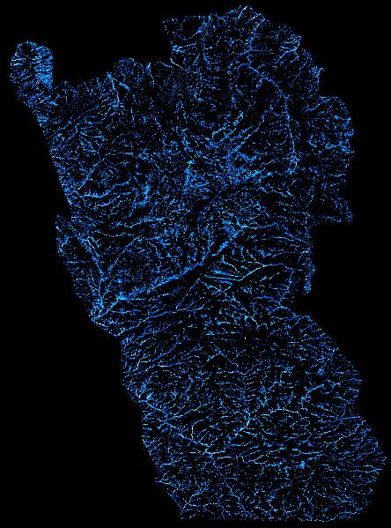
Combined Likelihood
16-17
14-15
11-13
9-10
8
6-7
0-5
Justin Wells

Slide 47
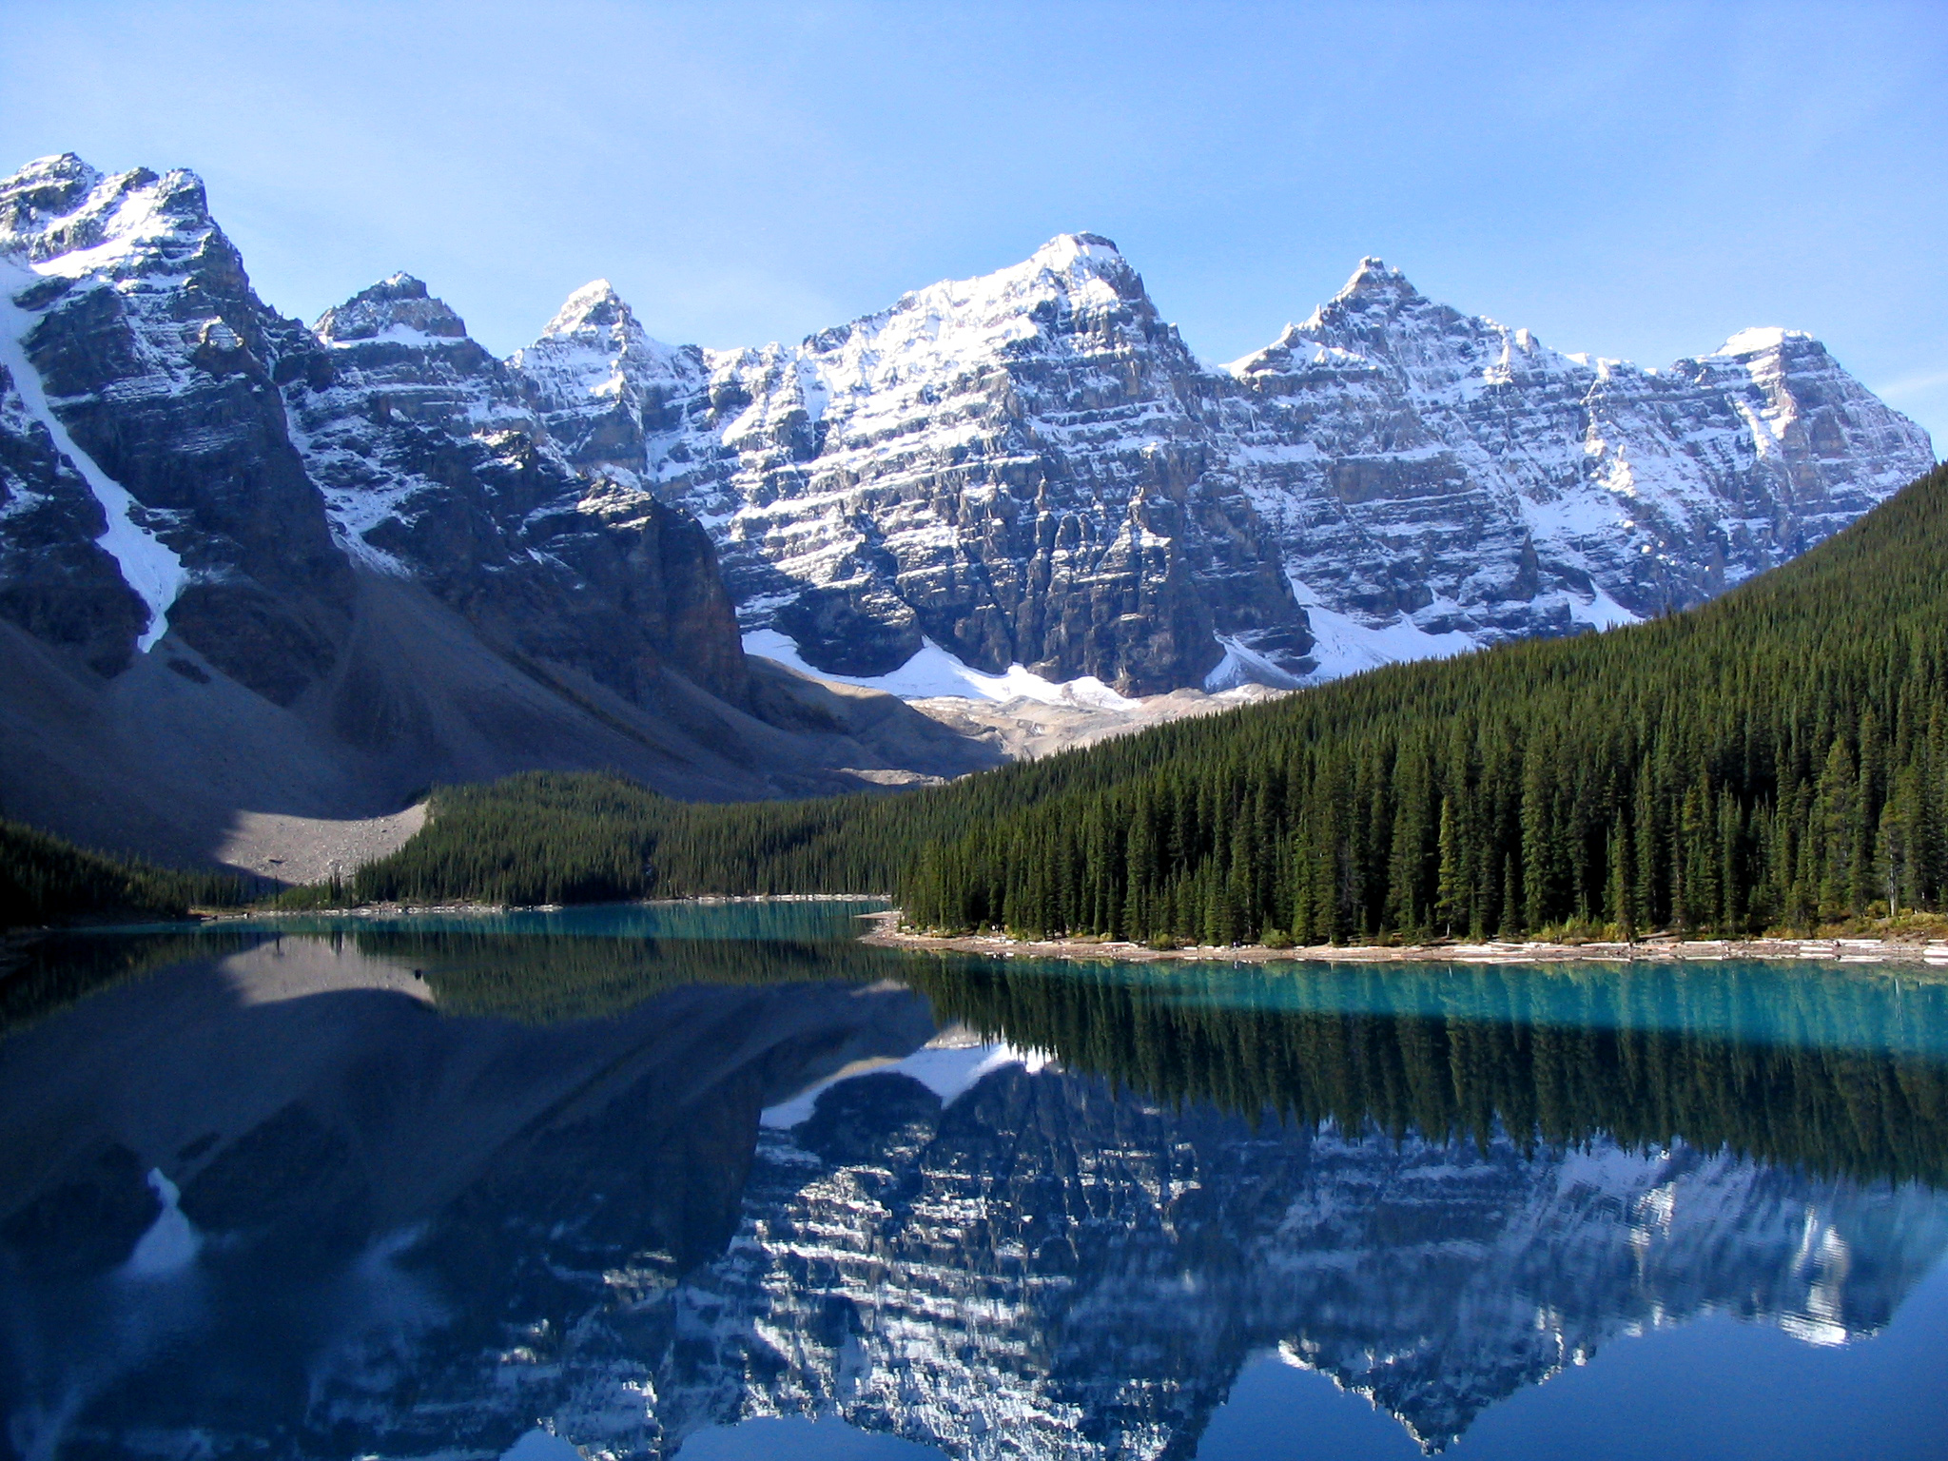
Conclusion
Conclusion
Accuracy Assessment
Radar could improve accuracy, but free radar data is only available in select locations
Characterizing and Classifying GDEs provides insight to larger-scale ecologic and hydrologic processes
Geospatial technologies could increase efficiency several fold for dozens of research teams across the nation
Justin Wells

Slide 48




Acknowledgements:
Narcisa Pricope Ph.D.

Slide 49
Works Cited
Denver Water, 2016, Water supply, http://www.denverwater.org/SupplyPlanning/WaterSupply/ (accessed October, 2016).
Eamus, Derek; Froend, Ray, 2006, Groundwater-dependent ecosystems: the where, what and why of GDEs, Australian Journal of Botany, v. 54, p. 91-96.
Heidel, B. and Jones, G., 2006. Botanical and Ecological Characteristics of Fens in the Medicine Bow Mountains, Medicine Bow National Forest, Albany and Carbon Counties, Wyoming. Prepared for the Medicine Bow-Routt National Forest. Wyoming Natural Diversity Database, University of Wyoming, Laramie, WY.
Kløve, Bjørn; Ala-aho, Pertti; Bertrand, Guillaume; Boukalova, Zuzana; Ertürk, Ali; Goldscheider, Nico; Ilmonen, Jari; Karakaya, Nusret; Kvœrner, Jens; Lundberg, Angela; Mileusnić, Marta; Moszczynska, Agnieszka; Muotka, Timo; Preda, Elena; Rossi, Pekka; Siergieiev, Dmytro; Šimek, Josef; Wachniew, Przemysław; Angheluta, Vadineanu; Widerlund, Anders, 2011, Groundwater dependent ecosystems. Part I: Hydroecological status and trends, Environmental Science & Policy, v. 14, p. 770–781.
Milner, Robert L.; Mitsdarfer, Charlie, 2015, Medicine Bow National Forest, Stateparks.com, web access 11 November, 2016.
Regional Plan Association, 2010, Front Range, http://www.america2050.org/front_range.html (accessed October 2016).
Wallace, Hansen, 1979, Climatography of the Front Range urban corridor and vicinity, Colorado, United States Geologic Survey, professional paper 1019, p. 59.

